Slide 1
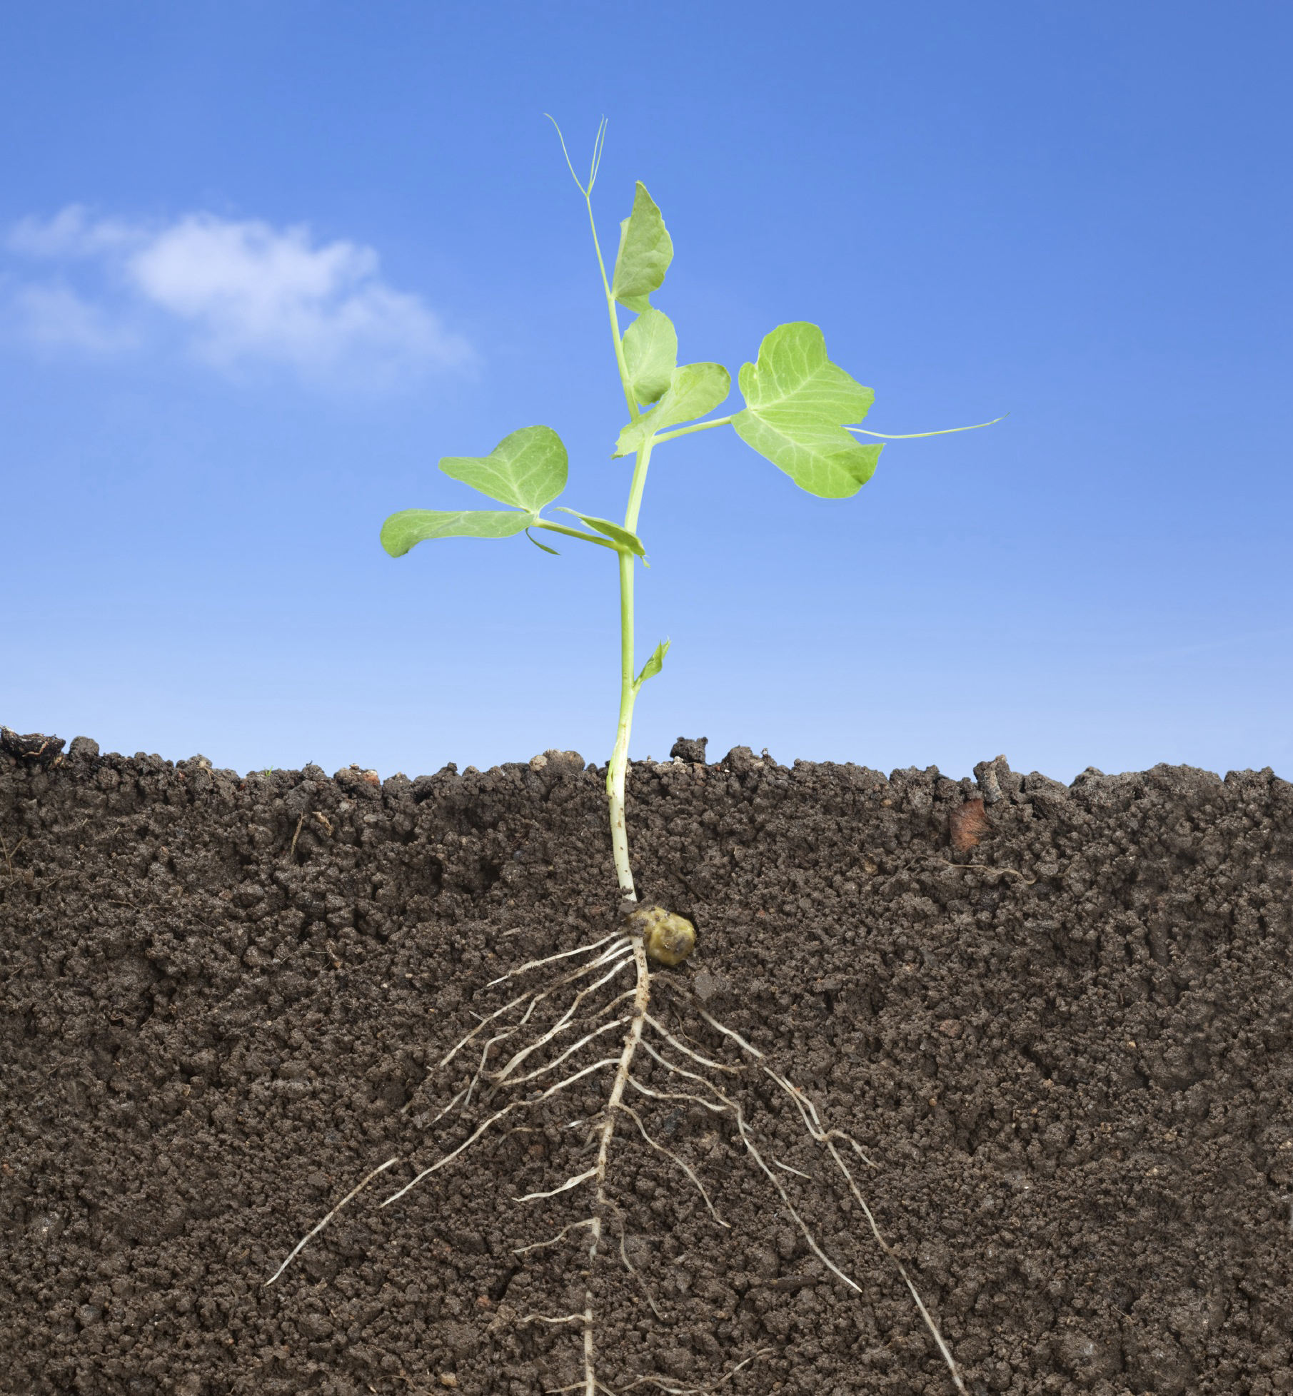
Introduction
Name: Lexie Foster
Department: Genetics, Cellular, and Molecular Biology, Master’s Degree
Schachtman Lab in the Beadle Center
UNL Root and Soil Microbiome Lab

Slide 2
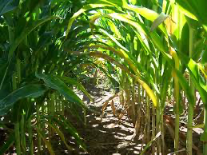
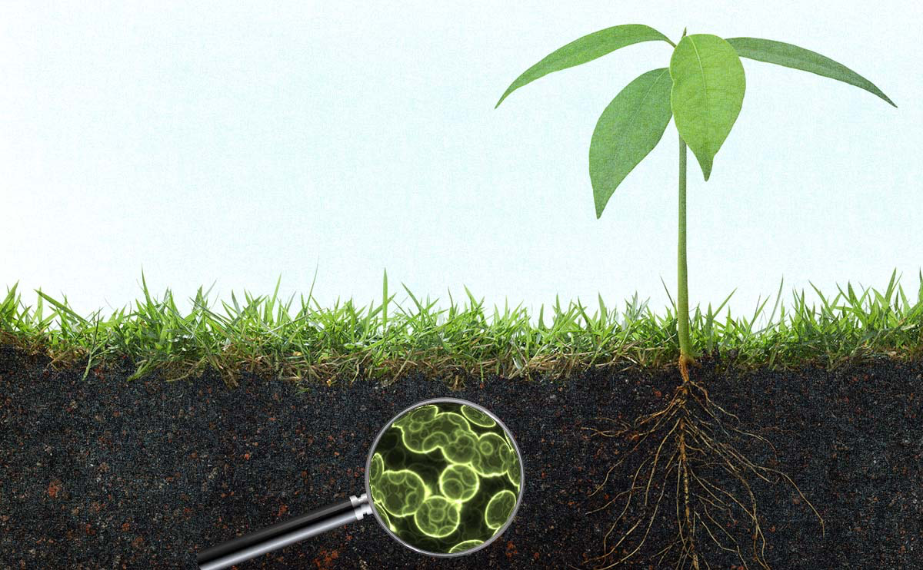
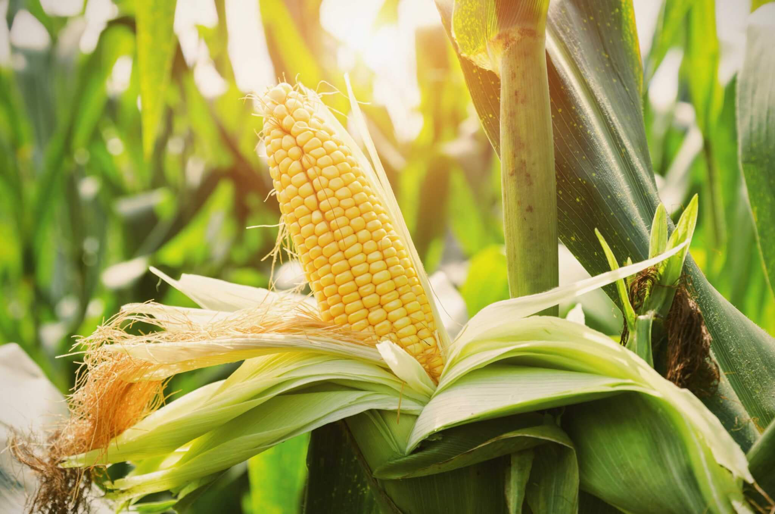

Overarching Question: Testing NUE-related phenotypic effects of potentially beneficial microbes
Selects for…
Because of…
HYPOTHESIS:
A potentially beneficial NUE-phenotypic effect!
Nitrogen-deficient maize
Certain bacterial groups
Research Questions:
What bacterial species are selected for under high versus low nitrogen conditions and how do the two groups differ?
Do the bacterial species chosen in low-nitrogen conditions offer a beneficial NUE-related phenotypic effect for maize in a nitrogen-deficient environment?

